Slide 1
Introduction to Access - Part 8
Finding a Record
Creating a Calculated Field in a Table
Problems

Slide 2
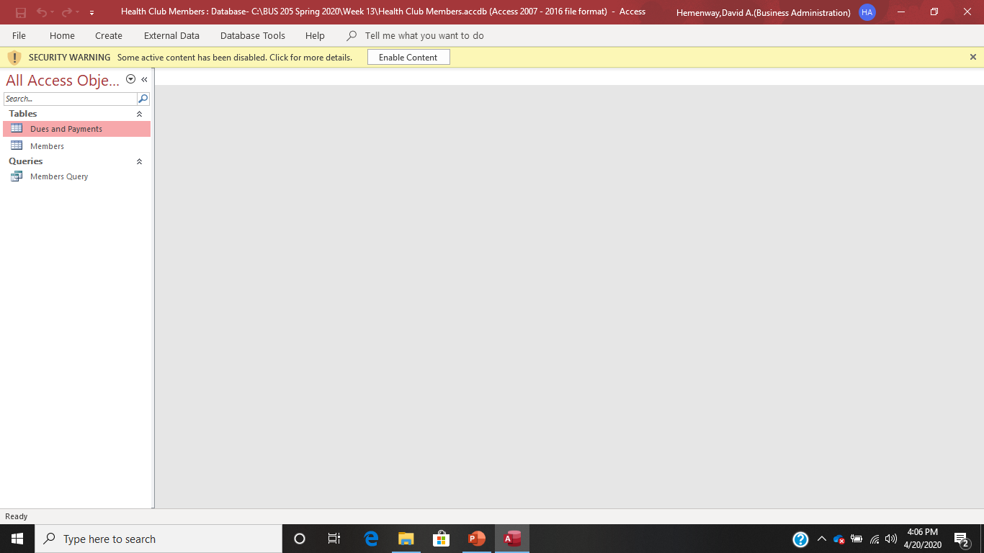
Open up the Health Club Members database. Remember to Enable Content.

Slide 3
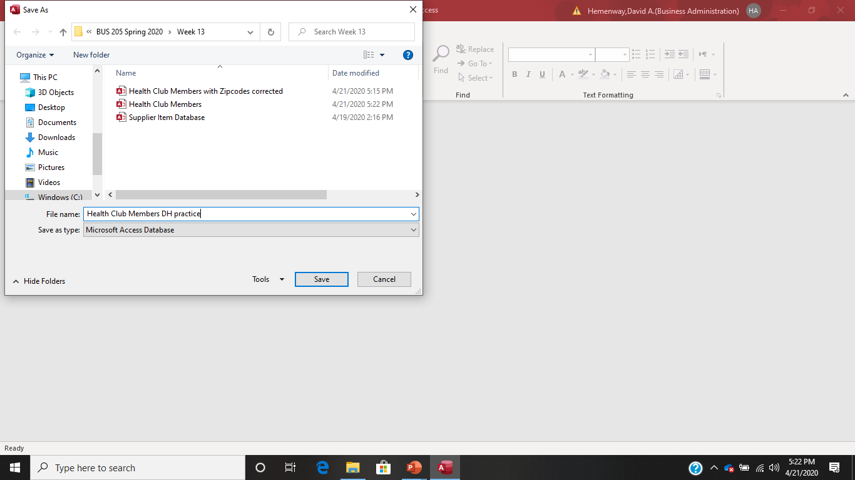
You might want to save Health Club Members as a practice file so you don’t corrupt the original database!

Slide 4
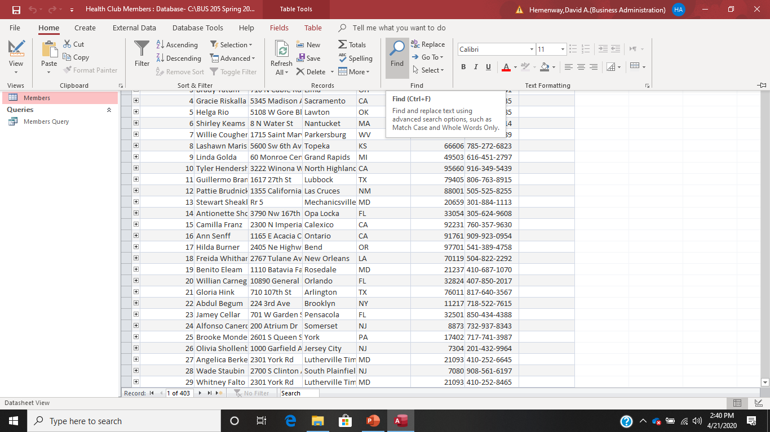
Open the Members table, select the Home key and choose the magnifying glass.

Slide 5
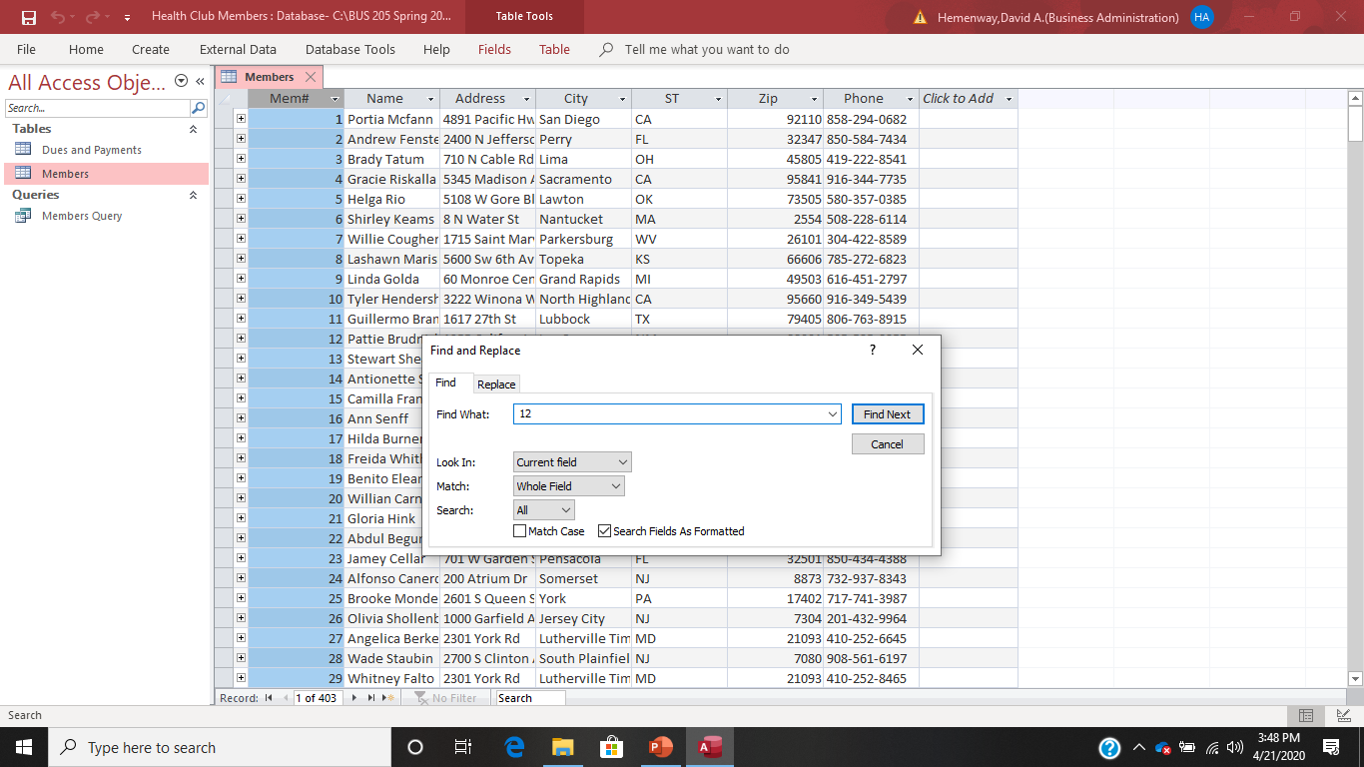
Let’s find member number 12! Highlight the Mem# field, select the Home option and choose the magnifying glass to get this screen. In the Find What: key in 12 and select Find Next

Slide 6
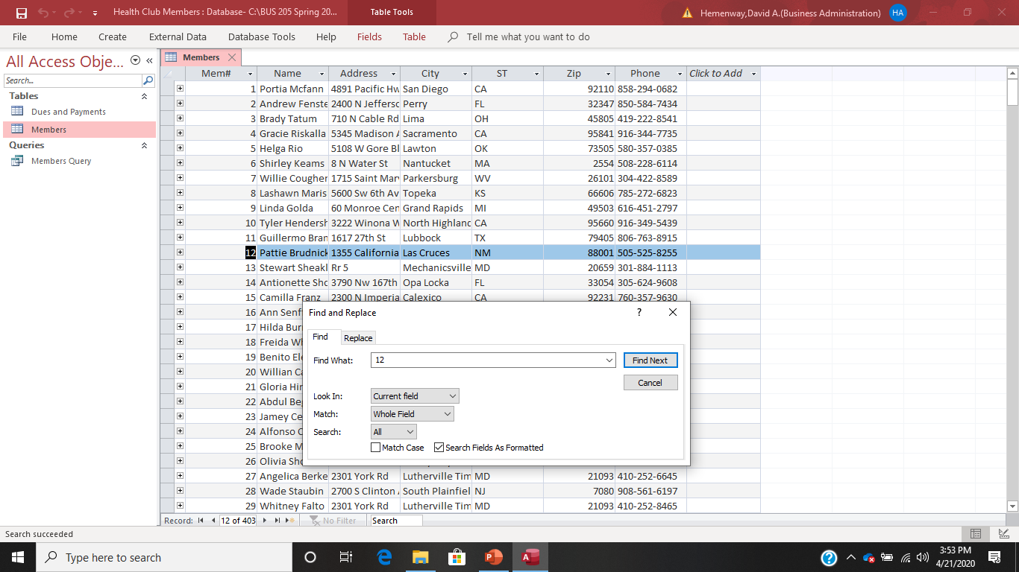
And we find the record for member number 12!

Slide 7
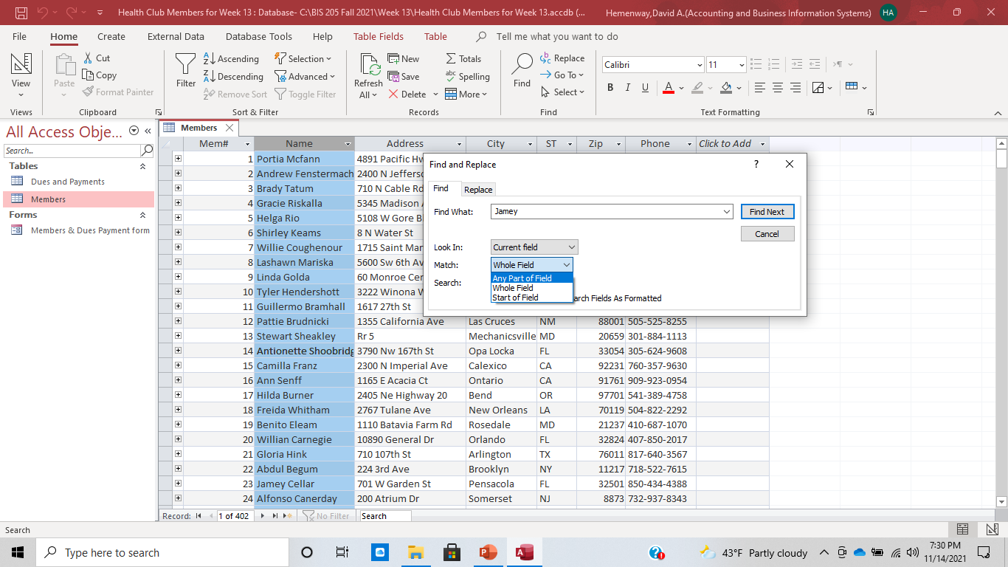
Let’s find Jamey in the Name field:

Slide 8
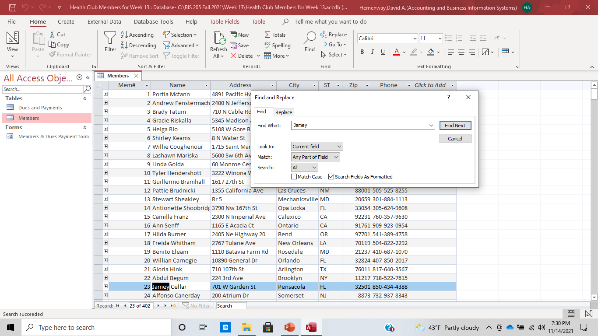
Jamey

Slide 9
Wildcard Characters for Searches: Source: Weverka, Peter, Microsoft Office 2019, 2019
Character | Description | Examples
? | A single character | B?t finds bat, bet, bit, and but
# | A single numeric digit | 9411# finds 94111, 94112, 94113, and so on.
* | Any group of consecutive characters | t*o finds to, two, and tattoo.
[xyz] | Any character in the brackets | t[aio]pper finds tapper, tipper, and topper, but not tupper.
[!xy] | Any character not in the brackets | P[!io]t finds pat and pet, but not pit and pot.
x-z | Any character in a range of characters | [1-4]000 finds 1000, 2000, 3000, and 4000, but not 5000. The range must be in ascending order.

Slide 10
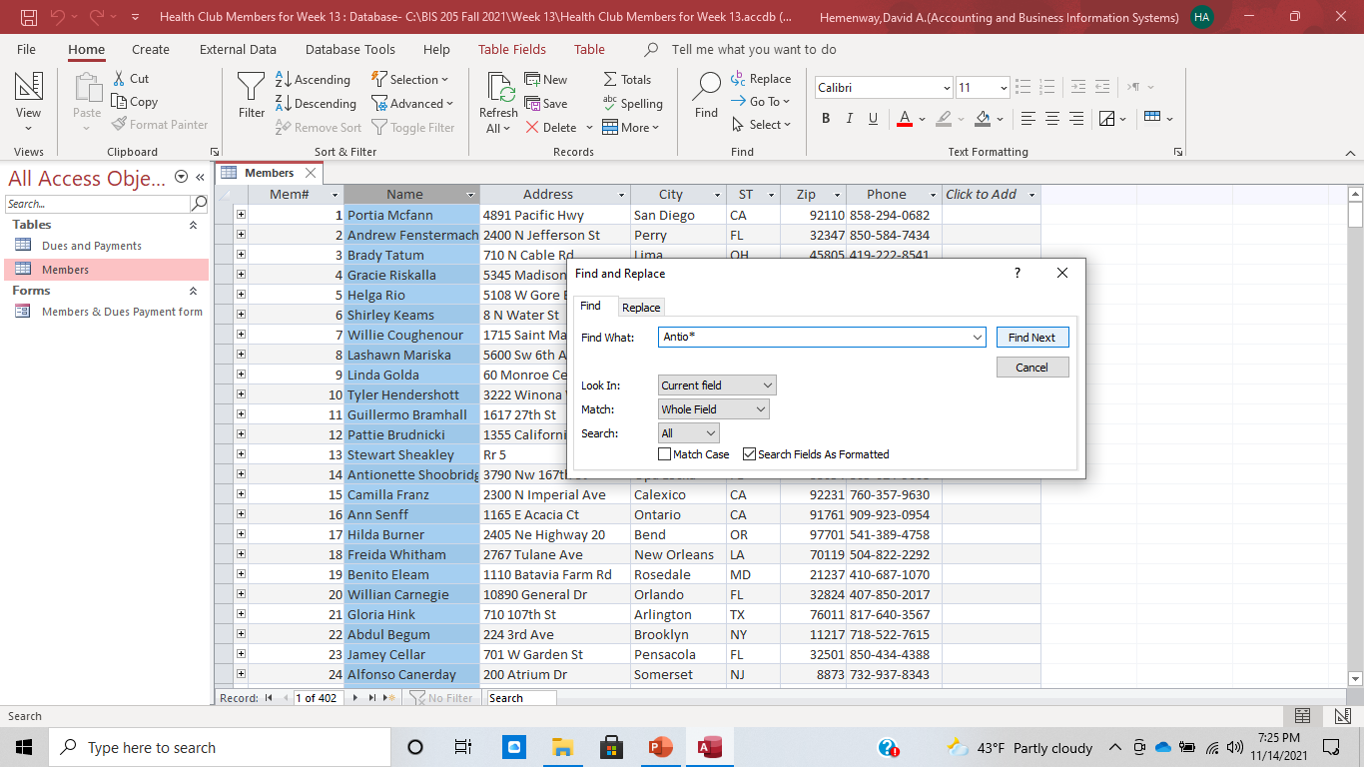
Let’s find Antionette in the Name Field:

Slide 11
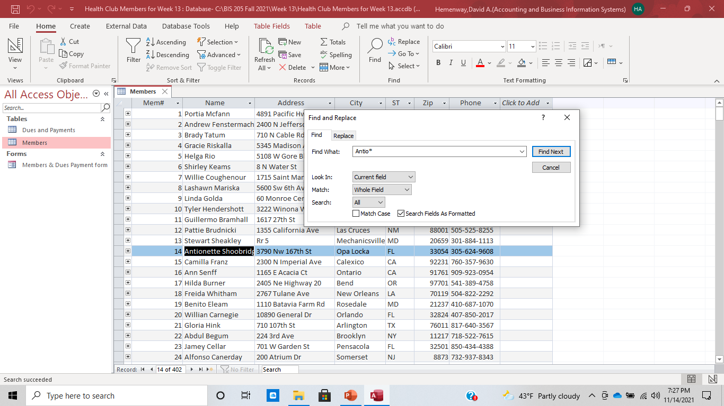
Let’s find Antionette in the Name field:

Slide 12
Aspects of the Find command:
The Find command only works in one table at a time. You MUST have the table open that has the information that you are seeking.
You can use wildcard characters in your searches

Slide 13
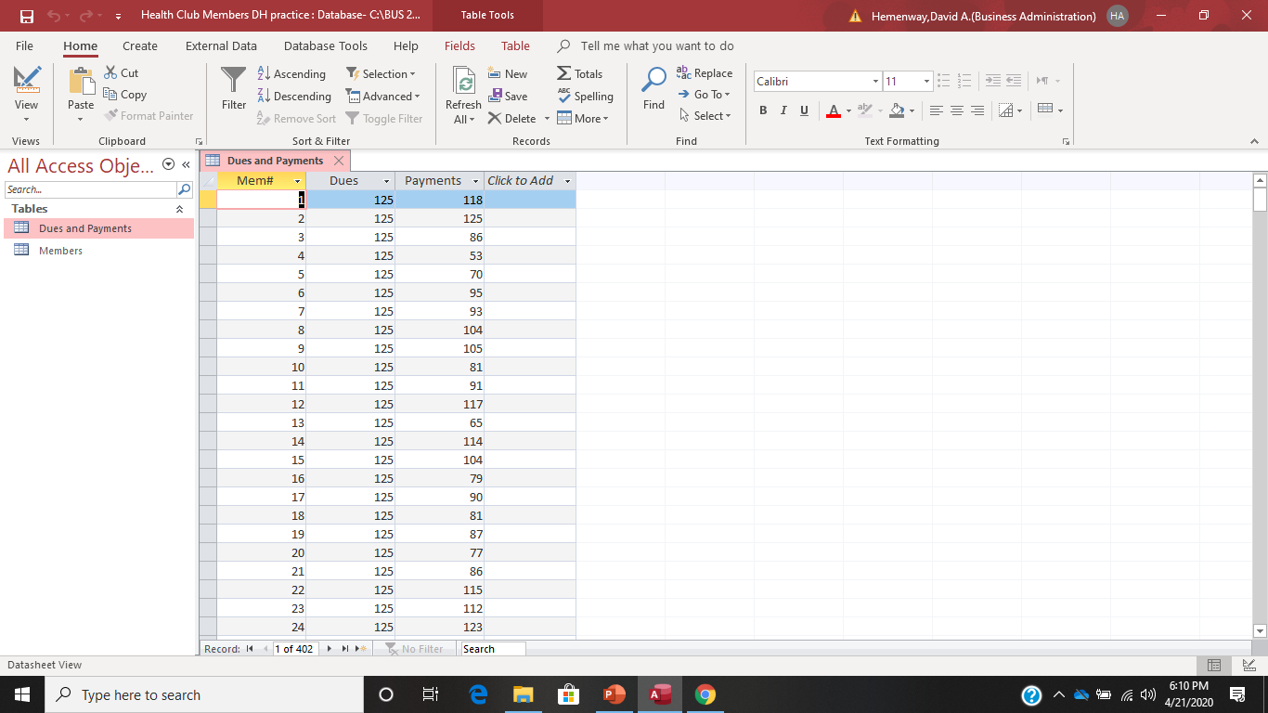
Making a New Field (Variable) Using a Calculation We want to make a new field to calculate how much each member owes in dues. Open the Dues and Payments table.

Slide 14
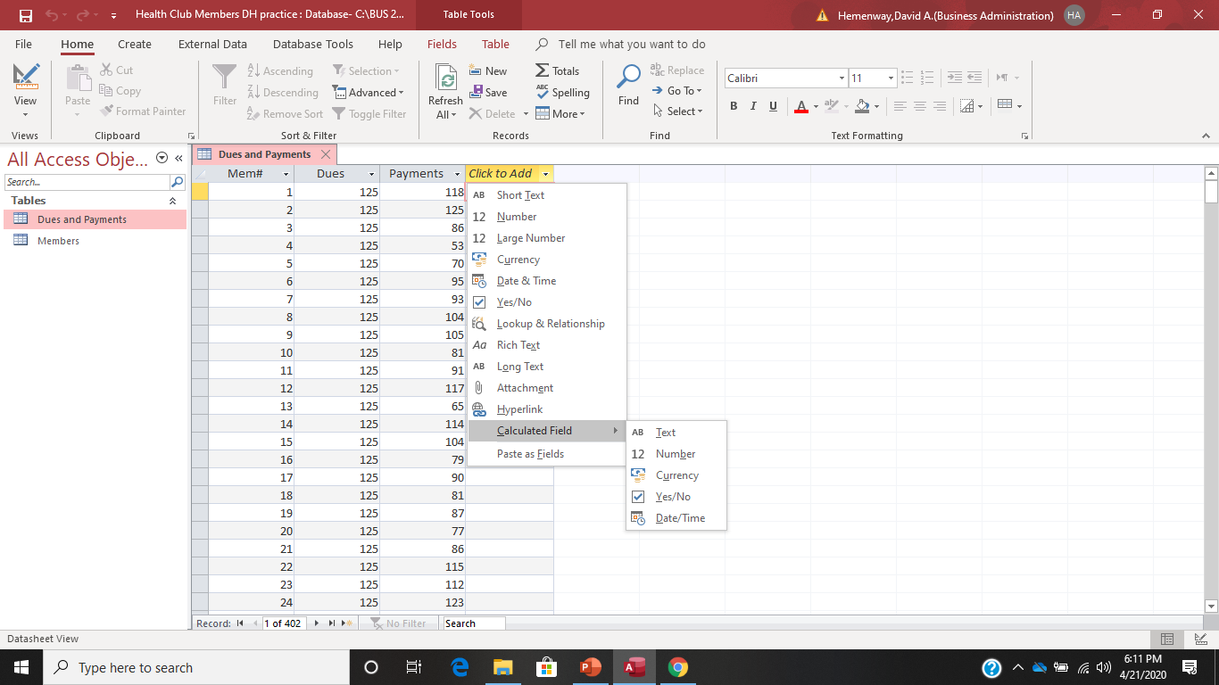
Go to the Click to Add column which is in the right most column, select Calculated Field and choose Number

Slide 15
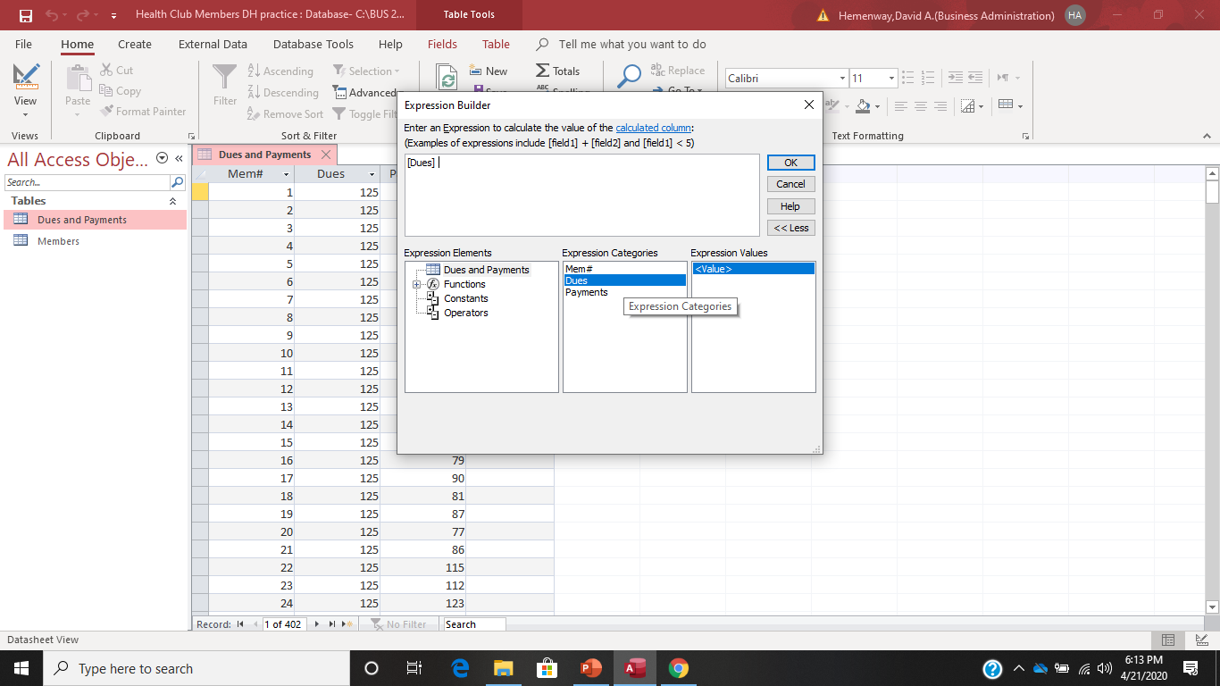
Select Dues and double click

Slide 16
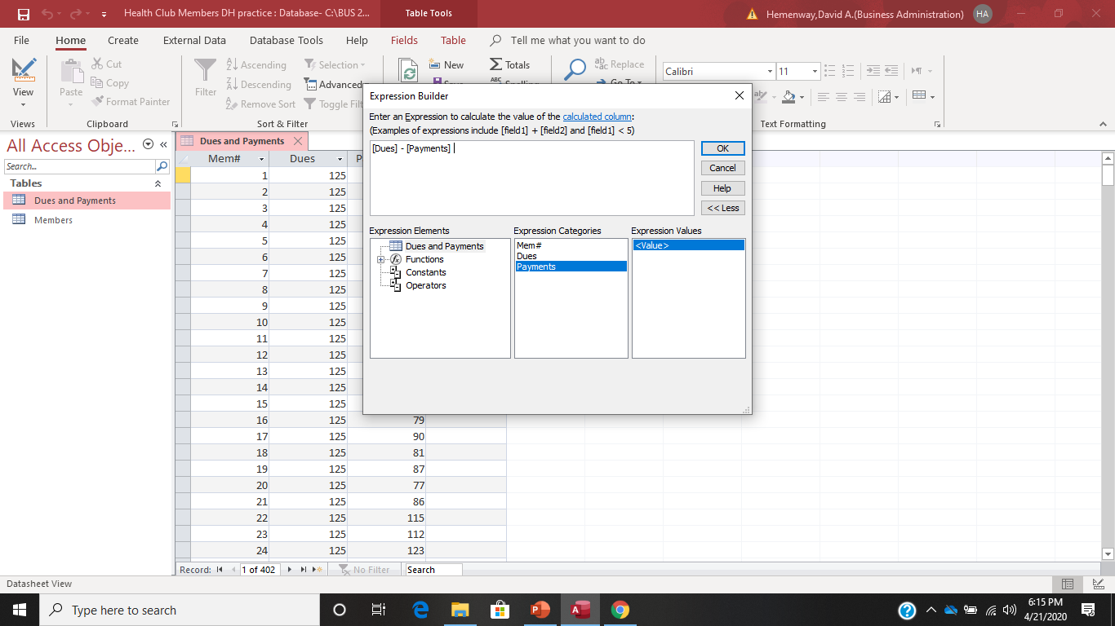
Type in a minus sign “-” and double click on Payments, then select OK

Slide 17
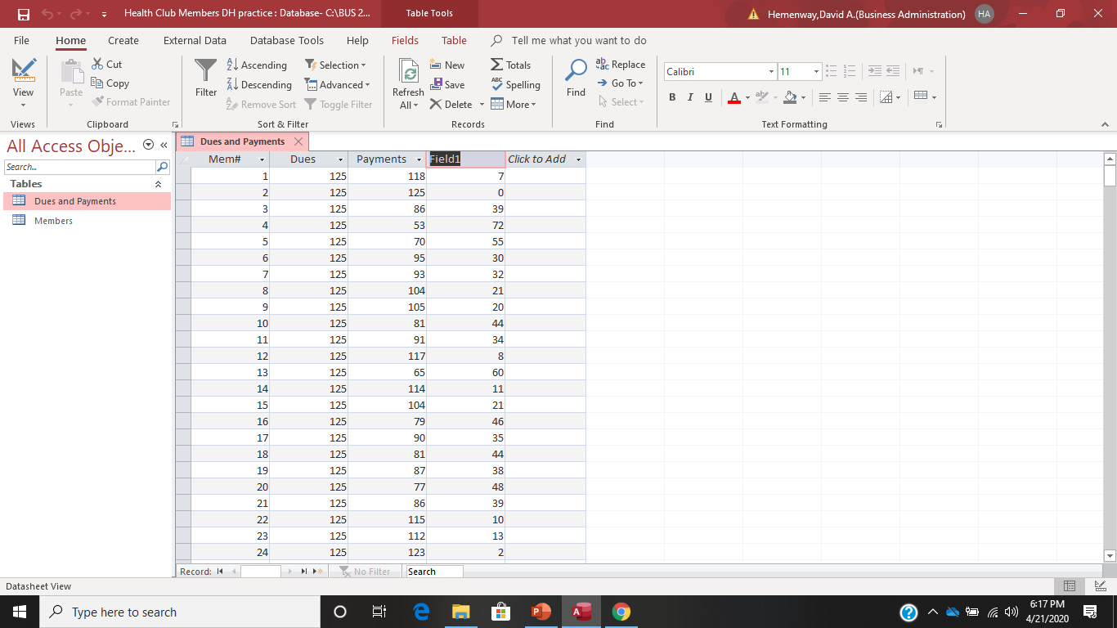
The result is this. Field 1 has been added to the Dues and Payments table.

Slide 18

Since Field 1 is not a very descriptive name, lets replace it. Backspace over the Field 1 field name and replace it with Owed.

Slide 19
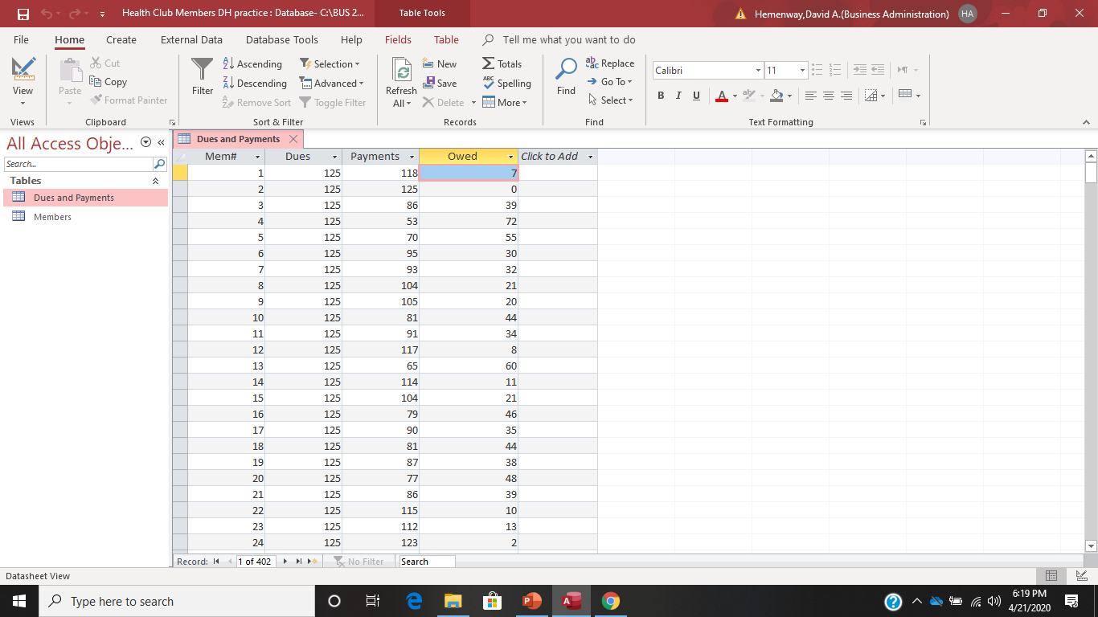
We have completed making a calculated field!

Slide 20
Things to Remember When Making Calculated Fields
The calculation cannot include fields from other tables or queries.
The results of the calculation are read-only.
Calculated fields are only available in Access databases using the .accdb file format.
You must be using Access 2010 or higher
Source: https://support.office.com/en-us/article/add-a-calculated-field-to-a-table-14a60733-2580-48c2-b402-6de54fafbde3

Slide 21
Process for Solving Problems
Read the question to gain an understanding of what the question is asking. Think about the question(s).
If necessary, sketch out what the question is asking.
Use Access functions to answer each part of the question. Check your work as you perform it.
Get your final answer and verify it. Does it make sense in the context of the database and the question? Think about it!

Slide 22
Problems
Problem 1 - You have been asked to produce a list of members in alphabetical order who live in Lutherville Timonium, Maryland (MD). Please produce this list.
Problem 2 - How many Health Club members owe money on their dues?
Problem 3 - Select all records that have a zip code that starts with “06”.
Problem 4 - Are there any duplicate records for any Health Club Members in Longwood, FL? If so, who are they and do they owe any dues?
Problem 5 - You noticed that some of the zip codes in your Health Club Members Database do not have a leading 0- so 06370 looks like 6370. How do you fix this and how do you correct your zip code data?

